Slide 1
Week 2
Geography – Mapping Skills

Slide 2
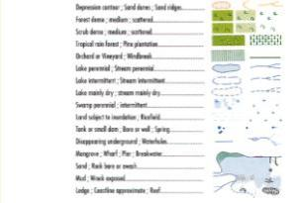
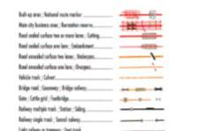
Physical and Cultural features
Cultural
Physical
Man made features – the human imprint on a landscape
e.g. landuses (built up areas, cleared areas, farming), settlement (farmhouses, towns), transport routes (highways, railways lines)
Natural features of a landscape
e.g. landforms (usually shown by contour lines), drainage (rivers, streams),
vegetation (forests, wooded areas, swamps

Slide 3
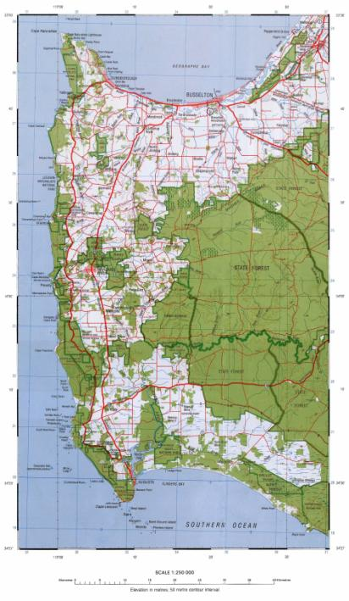
33 30’
33 40’
33 50’
34 00’
34 10’
34 20’

Slide 4

What is the latitude and longitude of Busselton?
115 18’ E
33 39’ S
On this map the black and white stripes form a border. Each of these represents 5’.

Slide 5
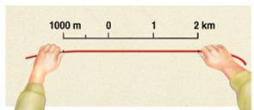
Calculating Distances
The distance between two points on a map can be found by measuring the distance on the map and then converting it from centimetres to kilometres and/or metres. Most students do this by using the map’s linear scale.
The distance between two points is measured in one of four ways:
Using a ruler
Using a straight edge
Using dividers
Using a piece of string or cotton

Slide 6
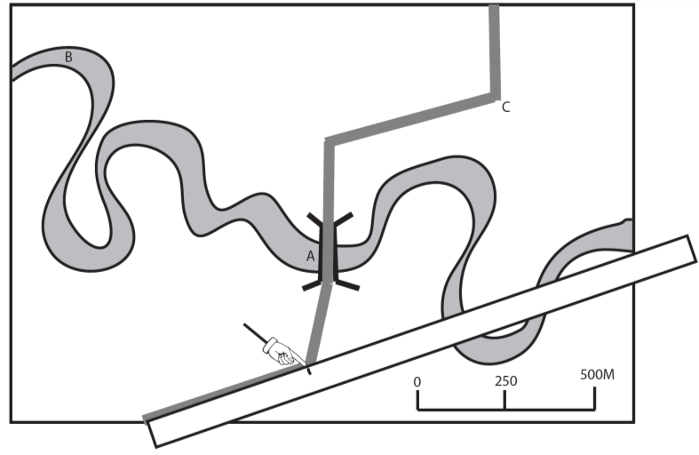
Calculating distances

Slide 7
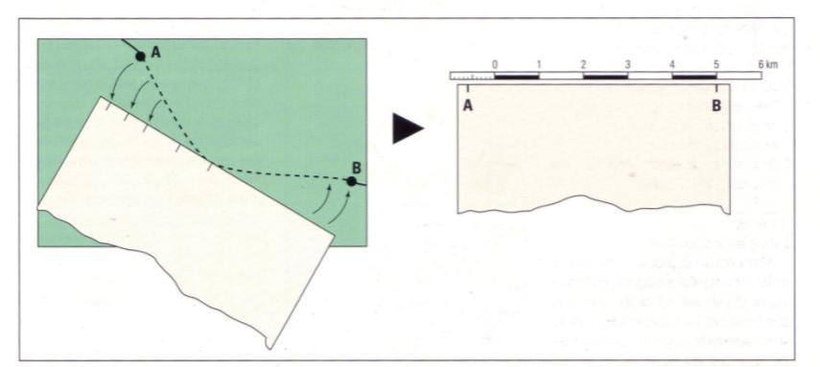
Measuring a distance along a curved line on a map

